Slide 1
THRIFTY WHEELS
Guide Name:
Sri K.Srikanth
Team members:
M.Kalyan Babu(179X1A0593)
N.Sai Suraj(179X1A0F3)
G.Akhil(179X1A0535)

Slide 2
ABSTRACT:
In this mini project we are going to provide information about automobiles. From this project the customers can gain the information about automobile company, model and some more information about the cars. Before buying a car it’s best to compare its feature and characteristic with other cars. This project focuses on providing best information and dealings to buy a car.
Platform and Technologies used:
HTML, CSS, JavaScript, PHP, MySQL.
Windows Operating System.
About the Project:
In this fast moving world automobile plays a very powerful role in the field of transportation. For some people it is a long term goal to buy a car. It is a long lasting product and people can’t effort to change it every year. So it is always a best practice to buy the best car as per our comfort and requirement. There are many aspects to decide on while purchasing the car like cost, fuel efficiency appearance, performance, safety, comfort, reliability, mileage, resale value etc. It is very important to have a clear picture of the car that you wish to buy. So we decided to bring a detailed information about automobile.

Slide 3
Platform and Technologies
HTML,CSS,Javascript,PHP,MySql
Windows operating System.

Slide 4
Modules:
→Home
→Admin Login
→Upload
→Signup
→Cars Display

Slide 5
Implementation

Slide 6
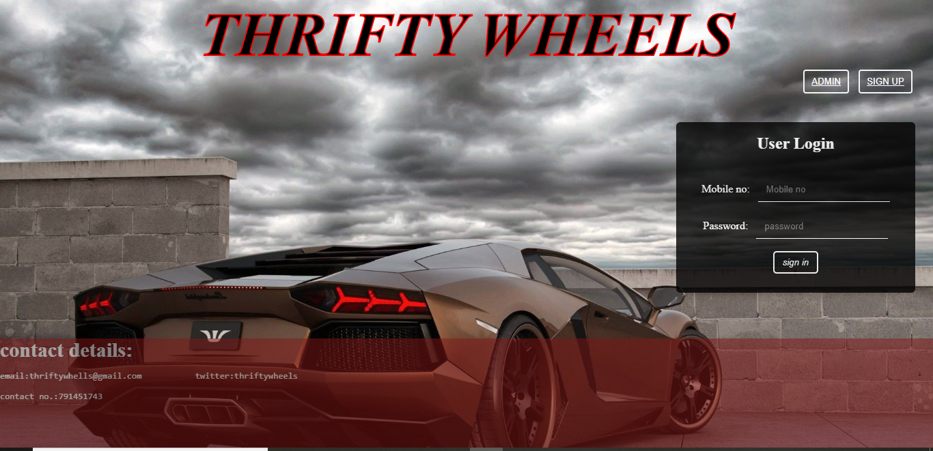
Home Page

Slide 7
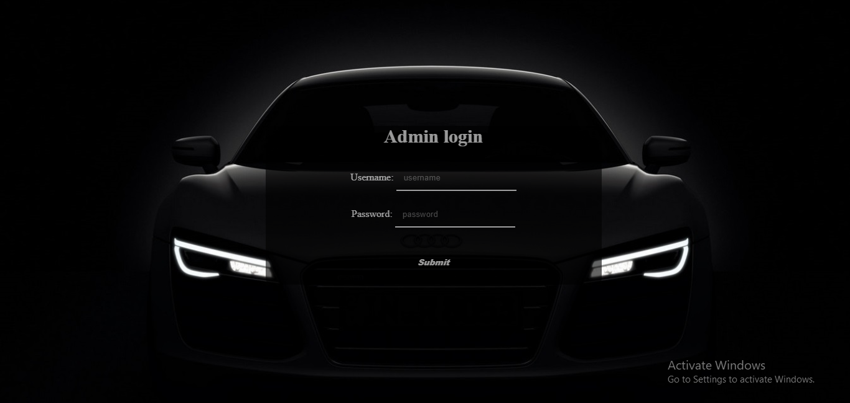
Admin Login

Slide 8
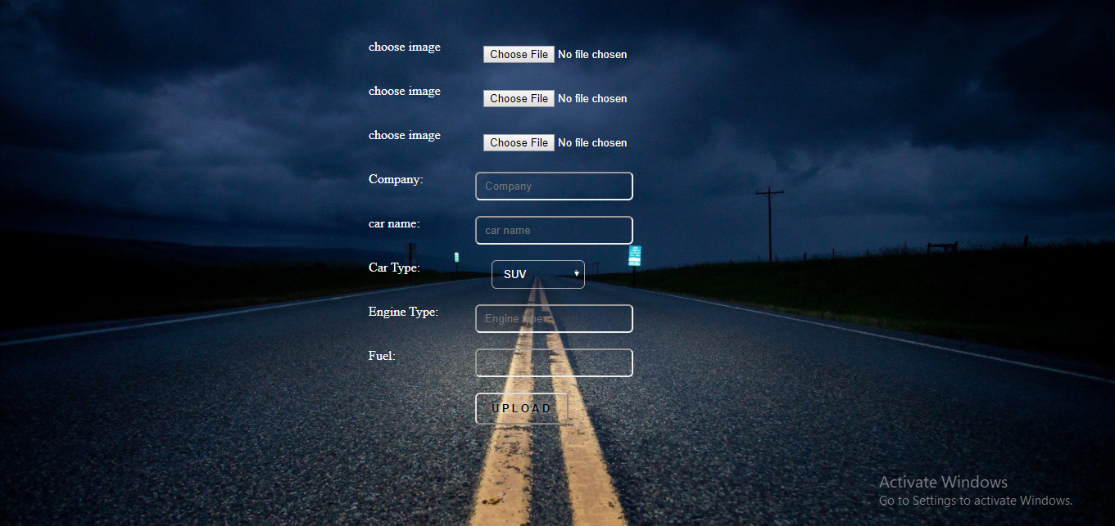
Upload

Slide 9
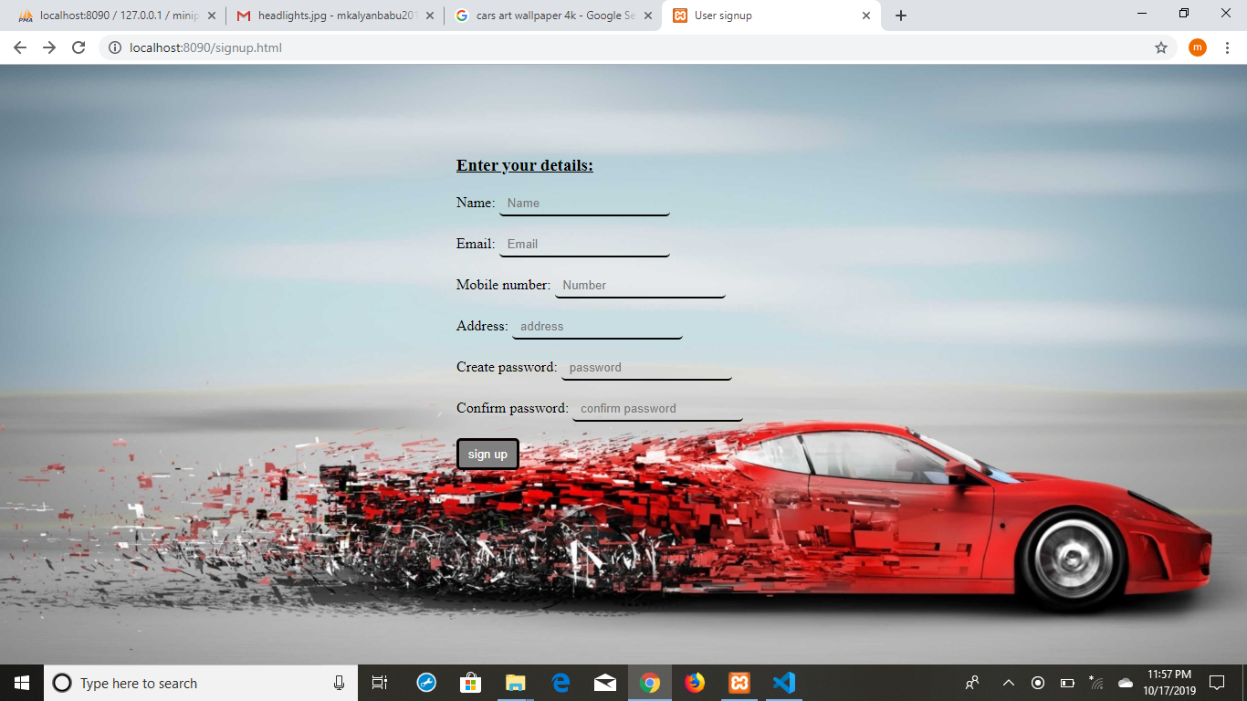
Signup

Slide 10
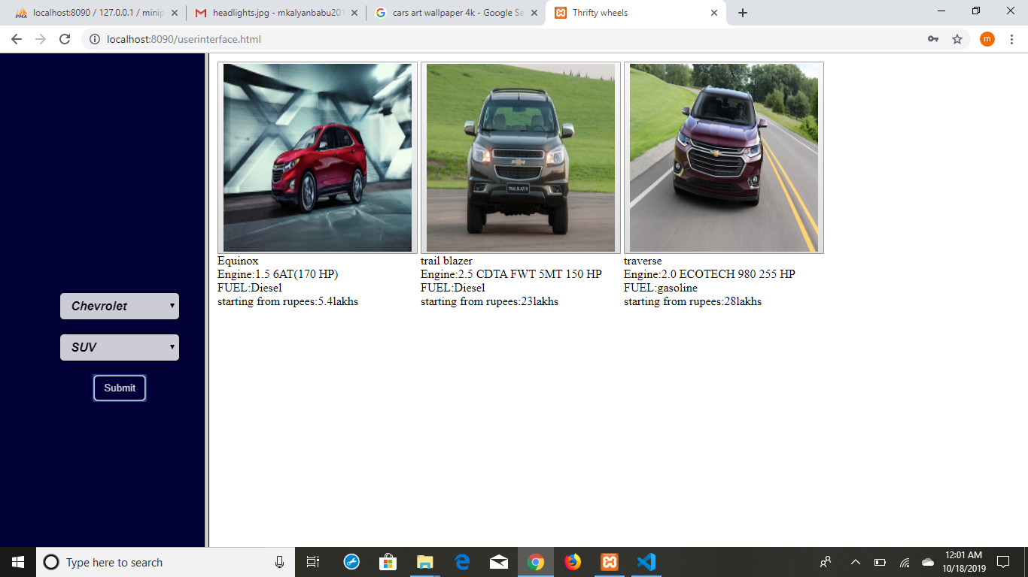
Cars Display

Slide 11
Conclusion

Slide 12


